Slide 1
Modeling for energy systems Lab 6- LPs in Python with Pyomo and glpk
Prof. Luana Medeiros Marangon Lima
Master of Environmental Management Program
Nicholas School of the Environment - Duke University
Fall 2022

Slide 2
Agenda
Quiz #5
Intro to the Pyomo library for solving optimizations models
Solver integration
Model implementation – approach #1
A5 Q&A

Slide 3
Intro LPs/PYOMO

Slide 4
Intro Pyomo
Pyomo - Python Optimization Modeling Objects

Slide 5
Pyomo object model & components
model
Var()
domain
Constraint()
bounds
exp
Objective()

Slide 6
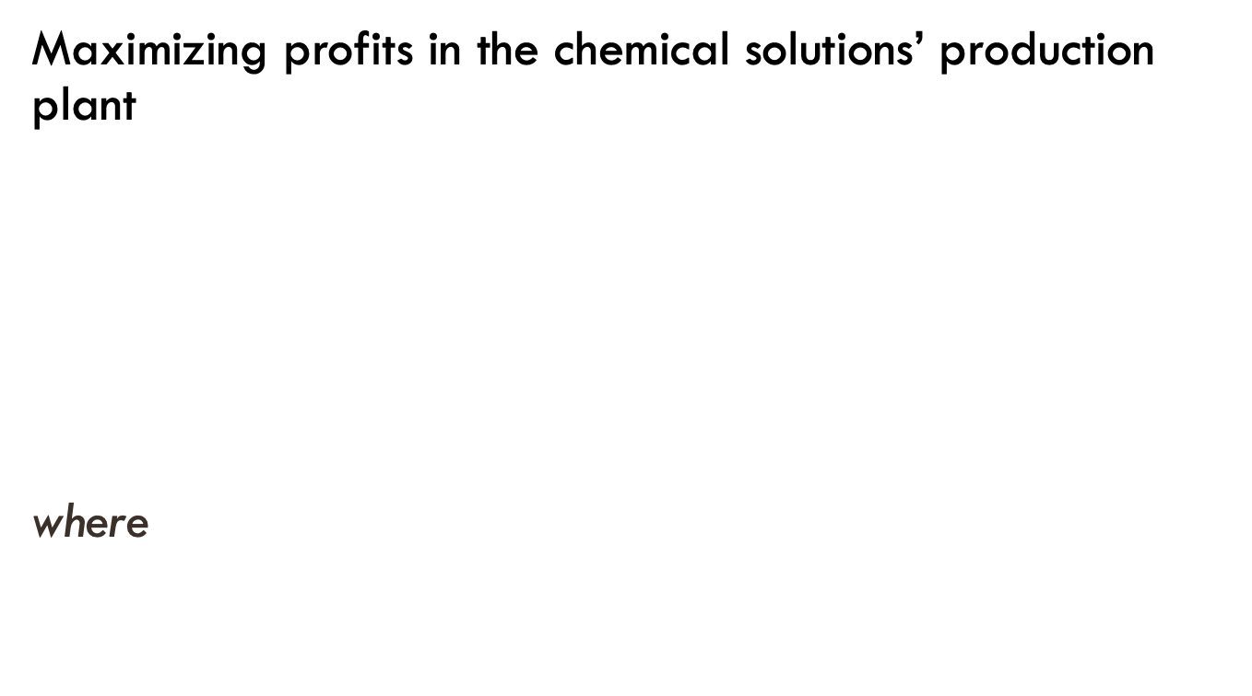
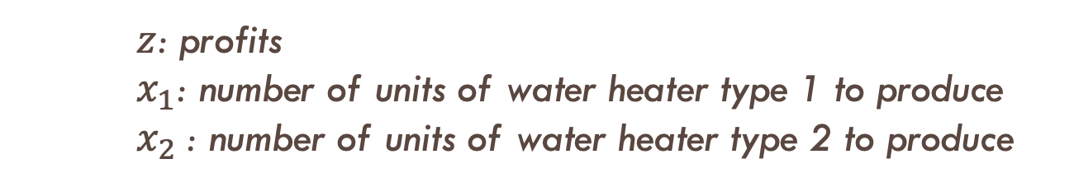
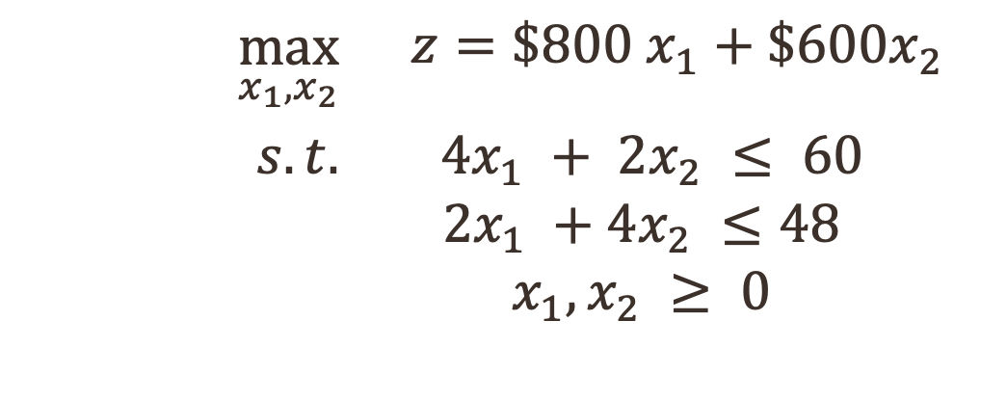
LP Formulation
Maximizing profits in the chemical solutions’ production plant
where
$$\max_{x_{1},x_{2}}$$ | $$z=\$800 x_{1}+\$600x_{2}$$
$$s.t.$$ | $$4x_{1} + 2x_{2} ≤ 60$$ $$2x_{1} +4x_{2} ≤48$$ $$x_{1}, x_{2} ≥ 0$$
$z$: profits
$x_{1}$: number of units of water heater type 1 to produce
$x_{2}$: number of units of water heater type 2 to produce

Slide 7
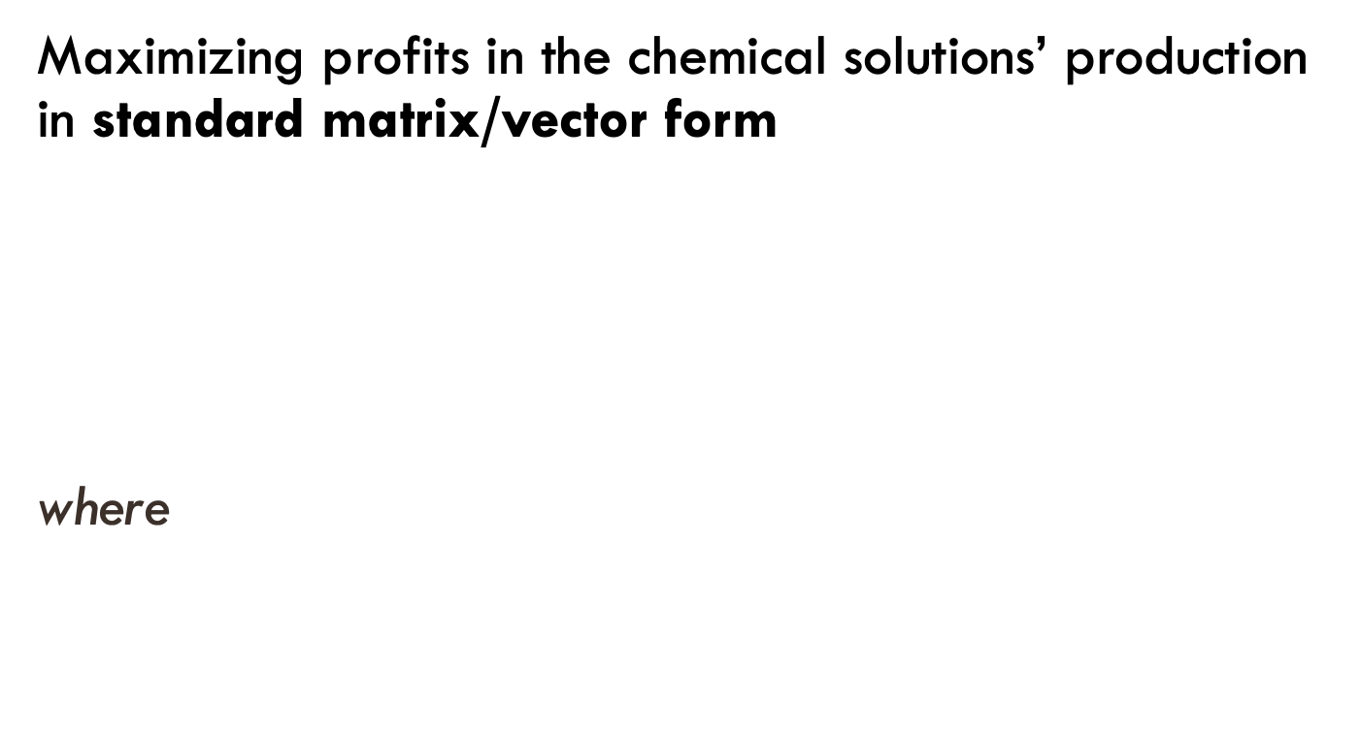
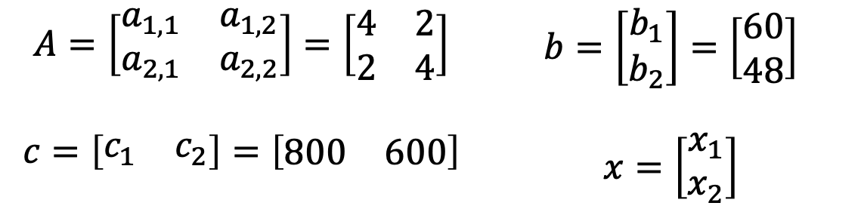
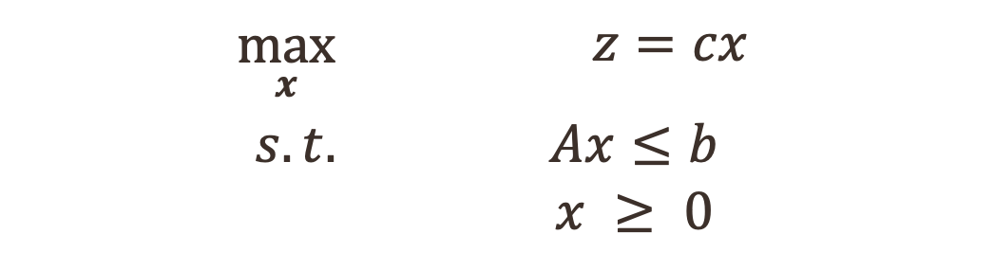
LP Formulation
Maximizing profits in the chemical solutions’ production in standard matrix/vector form
where
$$\max_{x}$$ | $$z=cx$$
$$s.t.$$ | $$Ax≤b$$ $$x ≥ 0$$
$$A=\left[\begin{matrix}a_{1,1} & a_{1,2} \\ a_{2,1} & a_{2,2}\end{matrix}\right]=\left[\begin{matrix}4 & 2 \\ 2 & 4\end{matrix}\right]$$ | $$b=\left[\begin{matrix}b_{1} \\ b_{2}\end{matrix}\right]=\left[\begin{matrix}60 \\ 48\end{matrix}\right]$$
$$c=\left[\begin{matrix}c_{1} & c_{2}\end{matrix}\right]=\left[\begin{matrix}800 & 600\end{matrix}\right]$$ | $$x=\left[\begin{matrix}x_{1} \\ x_{2}\end{matrix}\right]$$

Slide 8
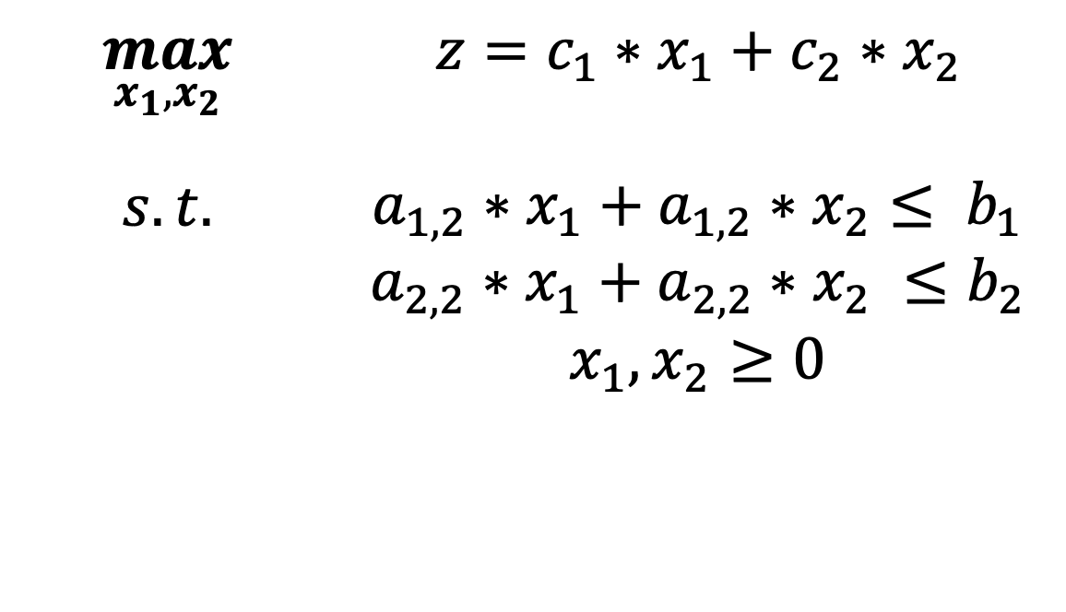
Final Formulation
$$\max_{x_{1},x_{2}}$$ | $$z=c_{1}∗x_{1}+c_{2}∗x_{2}$$
$$s.t.$$ | $$a_{1,2}∗x_{1}+a_{1,2}∗x_{2}≤ b_{1}$$ $$a_{2,2}∗x_{1}+a_{2,2}∗x_{2} ≤b_{2}$$ $$x_{1},x_{2}≥0$$

Slide 9
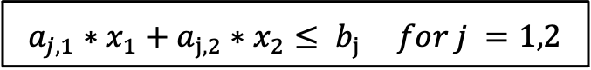
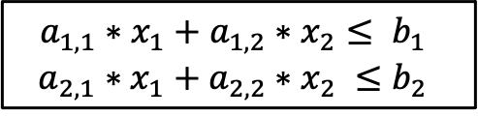
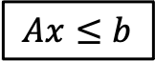
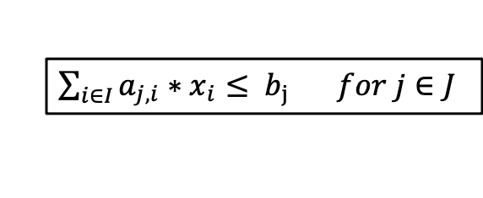
Set notation
$$Ax≤b$$
$$a_{1,1}∗x_{1}+a_{1,2}∗x_{2}≤ b_{1}$$
$$a_{2,1}∗x_{1}+a_{2,2}∗x_{2} ≤b_{2}$$
$a_{j,1}∗x_{1}+a_{j,2}∗x_{2}≤ b_{j}$ $for j =1,2$
$\sum_{i∈I}{a_{j,i}∗x_{i}≤ b_{j}} for j∈J$

Slide 10
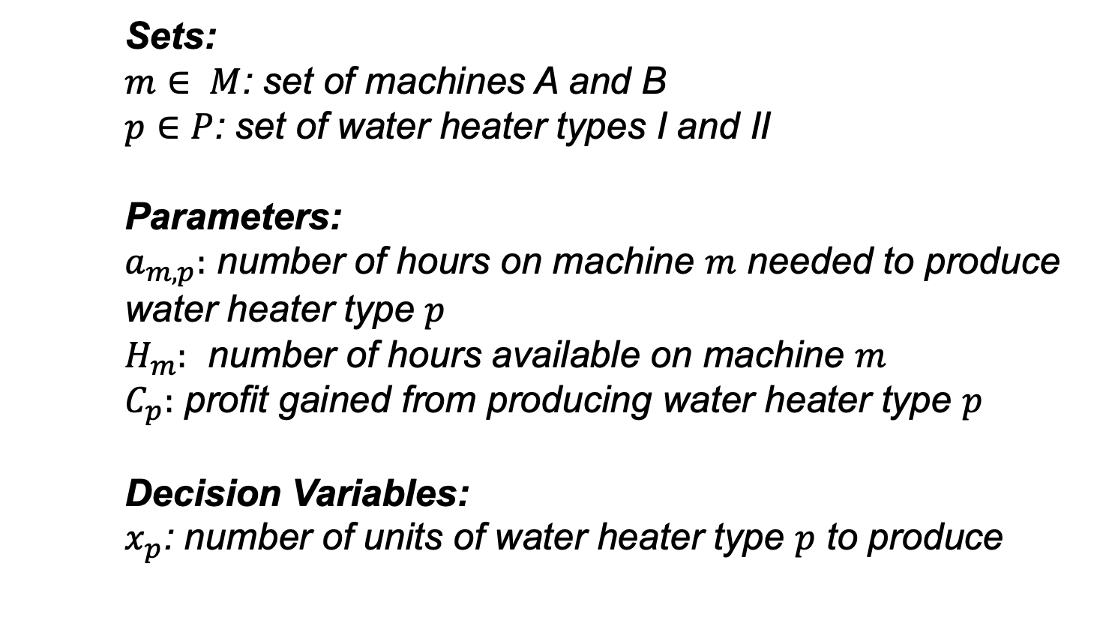
Indexing elements by set
Sets:
$m∈ M$: set of machines A and B
$p∈P$: set of water heater types I and II
Parameters:
$a_{m,p}:$ number of hours on machine $m$ needed to produce water heater type $p$
$H_{m}:$ number of hours available on machine $m$
$C_{p}:$ profit gained from producing water heater type $p$
Decision Variables:
$x_{p}$: number of units of water heater type $p$ to produce

Slide 11
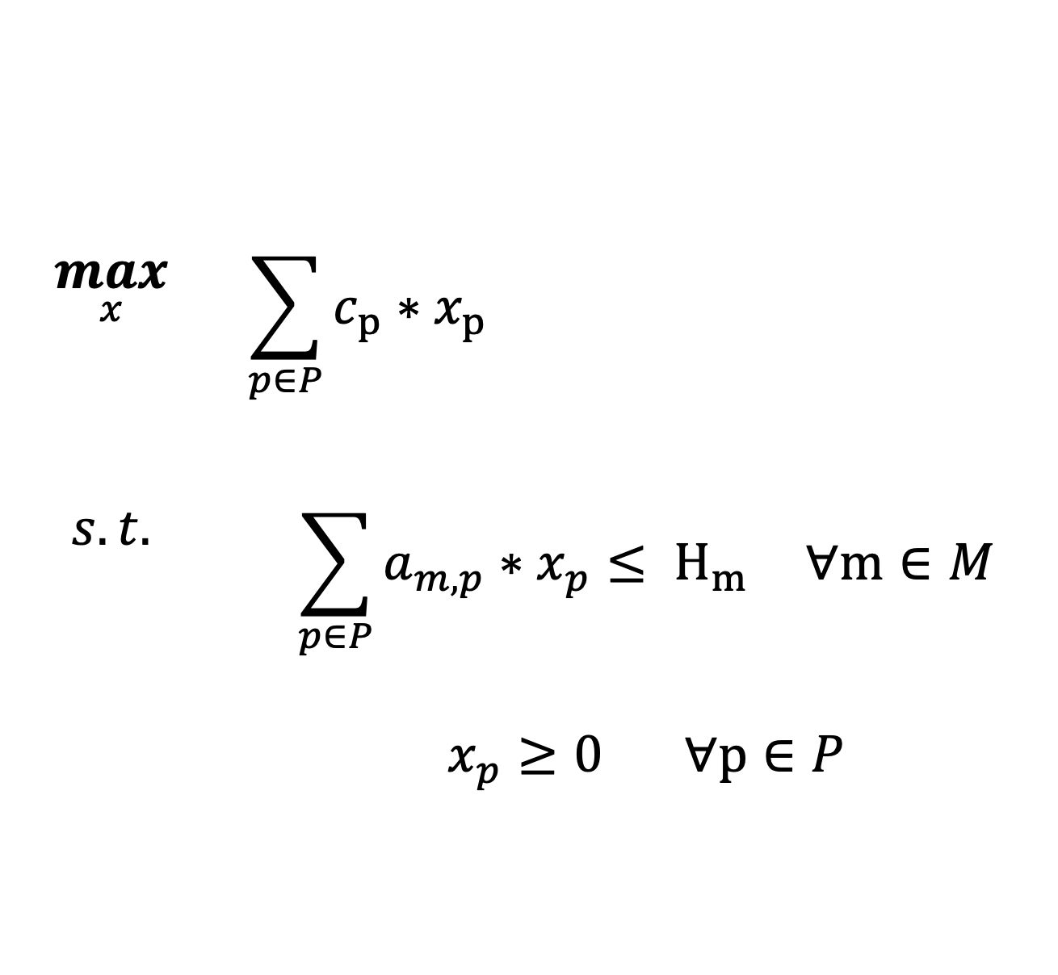
LP formulation using set index
$$\max_{x}$$ | $$\sum_{p∈P}{c_{p}∗x_{p}}$$
$$s.t.$$ | $$\sum_{p∈P}{a_{m,p}∗x_{p}≤ H_{m}} ∀m∈M$$ $x_{p}≥0$ $∀p∈P$

Slide 12
Recap – we will need it later!

Slide 13
UDFs in Python
In python you define an UDF using def keyword, followed by the function name
def function_name(argument1, argument2,…) :
statements
…
return output
Arguments are the inputs and could be a number or variable
Could also have optional argument that take a default value if not specified
Statements are the action to be performed in order to get the output
Output may be numeric or string

Slide 14
Dictionaries in Python
Similar to a list because it’s also a collection of elements
Dictionaries are associative arrays
Maps a key to its associated values
Structure
d = {
<key> : <value>,
<key> : <value>,
…
}

